Slide 1
DevOps Metrics

Slide 2

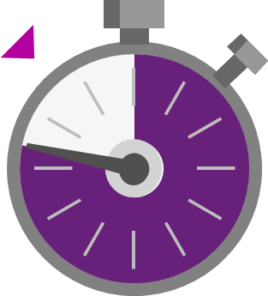

DevOps metrics
Deployment frequency
Change lead time
Change fail rate
Mean time to detect & repair
Agility performance indicators
Reliability performance indicators

